Slide 1
Ethics and obscenity
What is “dirty” and what is “clean?”

Slide 2
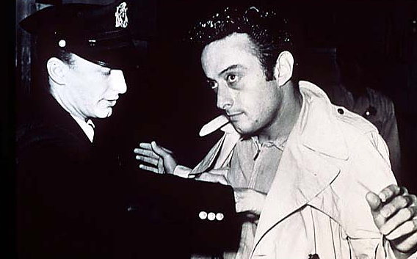
Ethics and obscenity
Lenny Bruce, a famous 1960s comic, explored the question of obscenity. He asked, “what is dirty, and what is clean?” in his 1960s monologues. [http://www.youtube.com/watch?v=gDkoCtMOFOg]
He said movie violence was “dirty,” while movie sex was “clean.”
Not many people in the United States would agree with him on that, even today.

Slide 3
Ethics and obscenity
Congress decided to explore the question of obscenity and pornography in a 1967 commission.
Three years later the commission issued a report: it could find no link between sexually explicit material and social harm, and advised repeal of obscenity laws.
In 1978 the FCC considered a comic influenced by Lenny Bruce: George Carlin.

Slide 4
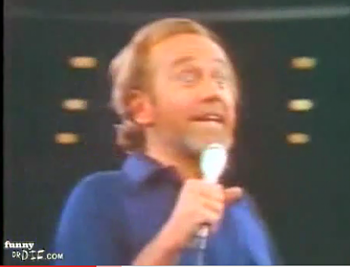
Ethics and obscenity
The FCC considered “obscenity” different from “indecency.” Indecent material might be protected under the Constitution. But it still might be offensive and inappropriate in some contexts.
George Carlin’s famous monologue was the basis for this case, the “Seven Words You Can’t Say on Television.” (Warning: naughty words.) [http://www.youtube.com/watch?v=3_Nrp7cj_tM]

Slide 5
Ethics and obscenity
The Carlin case stemmed from a case in which a New York radio station repeated some of the words.
The FCC claimed that was “patently offensive.” The U.S. Supreme Court agreed.
We do know that cable broadcasts are controlled as public airwaves are.

Slide 6
Ethics and obscenity
We have seen many other cases involving media use of obscenity, and legal attempts to define and control it.
Blasphemy is related to indecency. It is offensive or profane talk about God or religion.
All of this comes under the heading of “morally offensive” language—but not necessarily obscenity.

Slide 7
Ethics and obscenity
Legally, the First Amendment protects quite a lot of morally offensive speech—although not all.
But ethically, many groups will object to all kinds of things in the media as offensive.
They will protest shocking material, material that offends a standard of decency, is blasphemous, or promotes morally irresponsible behavior.

Slide 8
Ethics and obscenity
Many people and groups object to many things.
It is up to the media professional to sort out these claims to possibly offensive material.
Editors need to be sensitive to society’s concerns, but still not so morally narrow-minded that creativity or intellectually significant material is censored.

Slide 9
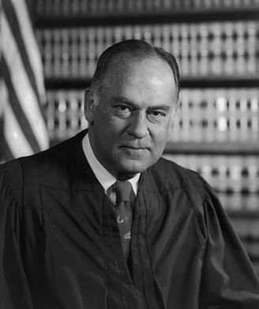
Ethics and obscenity
Is obscenity part of Constitutionally protected speech? The Supreme Court has said no, but has been unable to really define obscenity.
Supreme Court Judge Potter Stewart, when asked to define obscenity, famously replied that he couldn’t, but “I know it when I see it.”

Slide 10
Ethics and obscenity
In 1973 the Supreme Court settled on a definition of obscenity. Material is obscene if:
the average person, applying contemporary community standards and viewing the material as a whole, would find
that the work appeals predominantly to “prurient” interest;
that it depicts or describes sexual conduct in a patently offensive way;
that it lacks serious literary, artistic, political or scientific value.

Slide 11
Ethics and obscenity
That’s still a fairly ambiguous definition.
But what about the other point of view? We all know: sex sells.
On the internet, pornography apparently counts for one third of traffic.
It has always been an incredibly profitable industry. It still is.
Apparently it is worth billions: $97 billion world wide in 2006.

Slide 12
Ethics and obscenity
Some women’s groups have joined opposition to this huge industry, contending most pornography degrades women.
They ask for a new definition of pornography, one that puts women in roles of subordination.

Slide 13
Ethics and obscenity
Is there a link between pornography and sexual violence?
One famous study, the Meese Report in the 1980s, found none.
Other studies have found links.
Some studies seem to suggest pornography can actually lead to fewer sexual assaults. We still are uncertain.

Slide 14
Ethics and obscenity
What about the consequences of explicit music lyrics?
Eminem and other rappers in particularly have been criticized:
The Way I Am Whatever. Dre, just let it run Aiyyo turn the beat up a little bit Aiyyo.. this song is for anyone.. fuck it Just shut up and listen, aiyyo..
I sit back with this pack of zig zags and this bag Of this weed it gives me the shit needed to be The most meanest mc on this -- on this earth And since birth I've been cursed with this curse to just curse And just blurt this berserk and bizarre shit that works....

Slide 15
Ethics and obscenity
The FCC has fined radio stations for broadcasting such lyrics. But some believe it is applying a standard too conservative for contemporary American tastes.
Generally the law does seem to be unhelpful in defining obscenity.
We are left with our own ethical considerations as media practitioners.

Slide 16
Ethics and obscenity
Should a news program show nudity if it clearly adds to the meaning of a news story?
Should journalists quote George Carlin-style words if used by a politician during and interview? During a party?
Should print people use blanks or dashes, and broadcast people, bleeps for offensive words? Does this accurately reflect the story?

Slide 17
Ethics and obscenity
What do we consider acceptable? As both Bruce and Carlin pointed out, the media consider some words more acceptable than others. And times change.
“Bastard” and “condom” were once considered unacceptable in broadcast. Now they’re okay.
What about the so-called “colorful language” of sports? Do we bleep athletes?

Slide 18
Ethics and obscenity
Many newspaper editors have what is called a “family newspaper policy.”
This means they avoid offensive material—and often the definition is quite conservative.
Is it all right to quote someone using a taboo word in proper context? “He’s supposed to be taking it easy, the li’l shit.”

Slide 19
Ethics and obscenity
Broadcaster decisions are more difficult, even cable.
Television goes directly into people’s homes, so some feel it should be controlled more carefully. Children may be present.
The FCC carefully controls standard broadcast of radio and television, and they’ve recently proven to be quite conservative in defining what’s indecent.

Slide 20
Ethics and obscenity
In the 2004 Super Bowl, singer Janet Jackson’s “wardrobe malfunction” exposed a breast for less than a second.
The FCC fined CBS $500,000 for the incident.

Slide 21
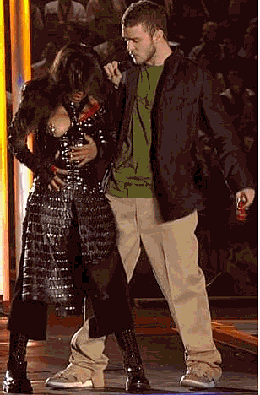
Ethics and obscenity
But standards vary. I was living in Paris at the time. French newspapers printed the supposedly indecent image on their front pages, and showed amusement over the supposed priggishness shown by the FCC and other Americans over this minor incident.

Slide 22
Ethics and obscenity
It’s not only a matter of a few “dirty words” or brief nudity on the air.
We have before talked about the 1987 case where the Pennsylvania state treasurer committed suicide on the air.
Many broadcasters censored this as too shocking, despite its obvious news value.
A few did show it.

Slide 23
Ethics and obscenity
But what level of violence is too shocking to publish or broadcast?
Is it unethical to show the result of terrorism, which might include blood, body parts or horrific damage?
Is it unethical to show the result of war, which might show similar things?
Is it ethically acceptable to show enemy dead, but not to show U.S. deaths in war?

Slide 24
Ethics and obscenity
Some editors have moved to showing more violent images from war.
This may be based on a changing standard during the Vietnam War, when war’s brutality became nightly television news.
One of the most shocking to Americans was film of the U.S. Air Force planes mistakenly bombing a village near Saigon with napalm. [http://www.youtube.com/watch?v=Ev2dEqrN4i0]

Slide 25
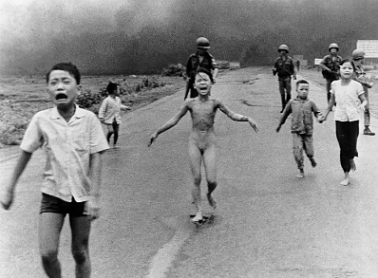
Ethics and obscenity
Not only does this video show violence, it shows nudity, and child nudity at that.
Would editors or news directors today move to censor such material?
It obviously was shocking—and still is. But ethical decisions consider other issues besides avoiding shock.

Slide 26
Ethics and obscenity
Pictures displaying nudity of any kind are offensive to some viewers and readers. This becomes a difficult ethical decision for media practitioners.
Some news directors and editors believe their audiences will never accept nudity, no matter what the justification. This, of course, would mean the Vietnam War bombing mistake video would never have been shown.

Slide 27
Ethics and obscenity
What about blasphemy? Some people think such a worry is old fashioned nowadays.
Legally blasphemy is clearly protected by the First Amendment.
But ethically? People have picketed or boycotted media material they believe ridicules Christ or denigrates Christianity.

Slide 28
Ethics and obscenity
Is it all right to offend a religious group not likely to respond, but avoid offending those groups that might respond in a dangerous way?
For example, is it all okay to burn the Bible because Christians won’t threaten violence, while it is forbidden to burn the Koran because Muslims might?

Slide 29
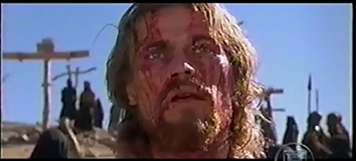
Ethics and Obscenity
In 1988 “The Last Temptation of Christ” was considered blasphemous, and was strongly protested by the “Religious Right.” [http://www.youtube.com/watch?v=DAqW315se-A]
But today the response might be more muted. Statistics show the United States has become less religious.

Slide 30
Ethics and obscenity
For those who believe media practitioners must uphold moral limits, for arguments are given:
1. To prevent harm to others. Society is damaged by pornography and other offensive material.
1. Paternalism: offensive material should be controlled prevent harm to one’s self. Pornography dehumanizes and corrupts values, and we need to be protected by that.

Slide 31
Ethics and obscenity
3. Moralism. Obscene material should be controlled to prevent immoral behavior; it might promote bad behavior and offend community standards.
4. Offense. Society needs to restrict liberty to prevent offense to others.

Slide 32
Ethics and obscenity
But others argue against media control of possibly offensive material.
1. There is no evidence that morally offensive material harms others or causes increase in crime.
The idea of “societal harm” is ambiguous.
2. Paternalists are wrong; material doesn’t seem to have much effect on individuals. Even if it did, it is wrong to limit people’s liberty by deciding what’s good for them.

Slide 33
Ethics and obscenity
3. Moralism is wrong, because an alleged “community standard” does not exist. Because such standards are so hard to define, limits end up being tyranny of the majority against an unprotected minority.
How would the great ethics philosophers view the question of media and obscenity?

